Slide 1
Demystifying
Game Design
Omar Shehata
Notes:
There are 3 types of attendees
-Interested, but not having time
-Just curious
-Already makes games
RESOURCE PAGE MENTION
Ask how many of each kind
Introduce yourself

Slide 2
Who Am I?
Omar Shehata
Student at Alexandria University
Game Developer/Programmer
Making games for 6 years
Notes:
3adatan bab2a merakez 3ala el programming and partner up with people who do the graphics
Here are some pics of my games

Slide 3
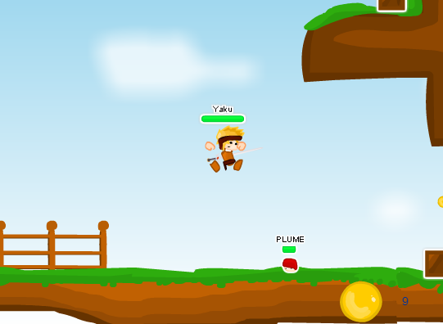
Some games I’ve made

Slide 4
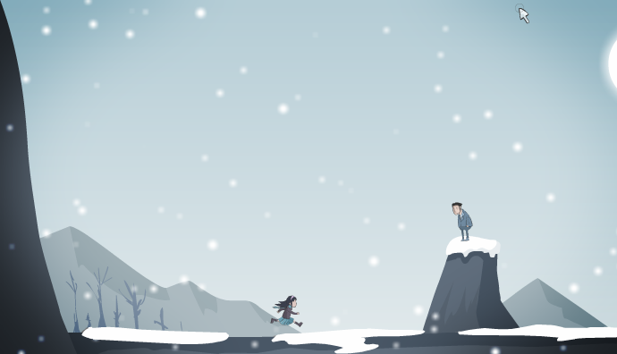
Some games I’ve made

Slide 5
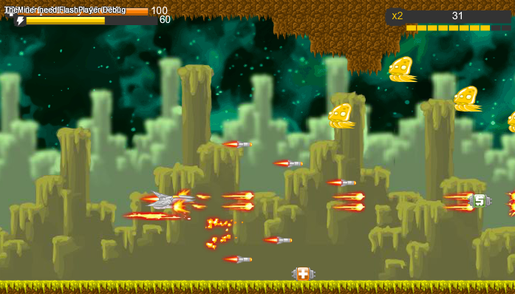
Some games I’ve made

Slide 6
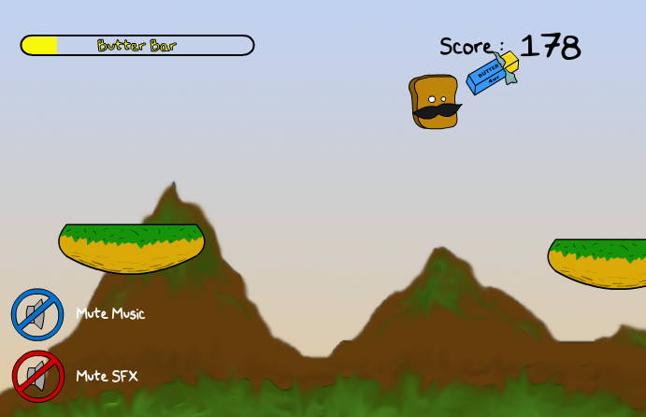
Some games I’ve made

Slide 7
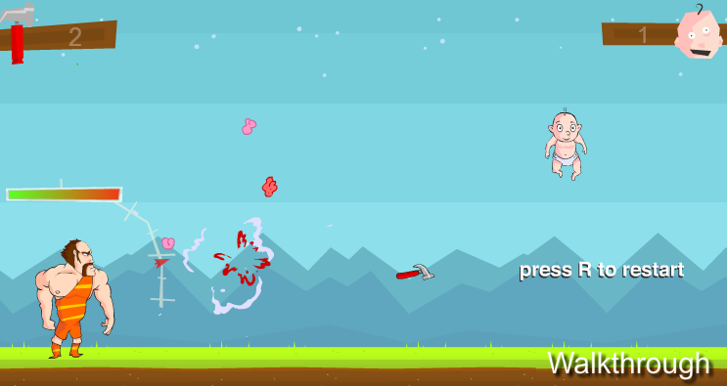
Some games I’ve made

Slide 8
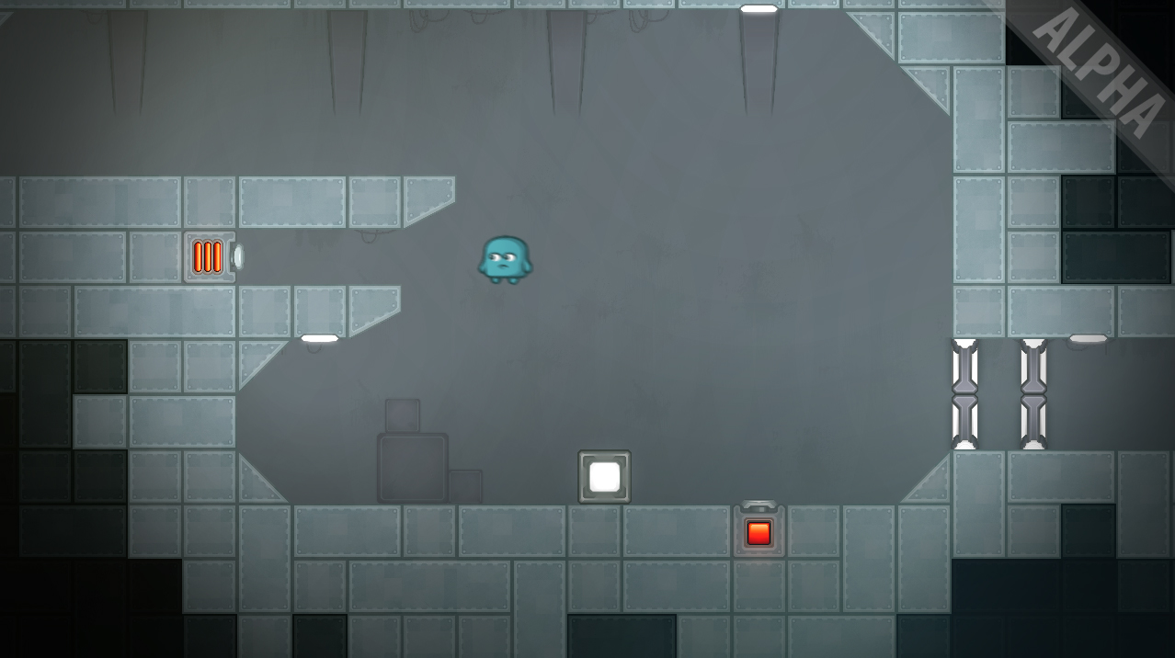
Some games I’ve made

Slide 9
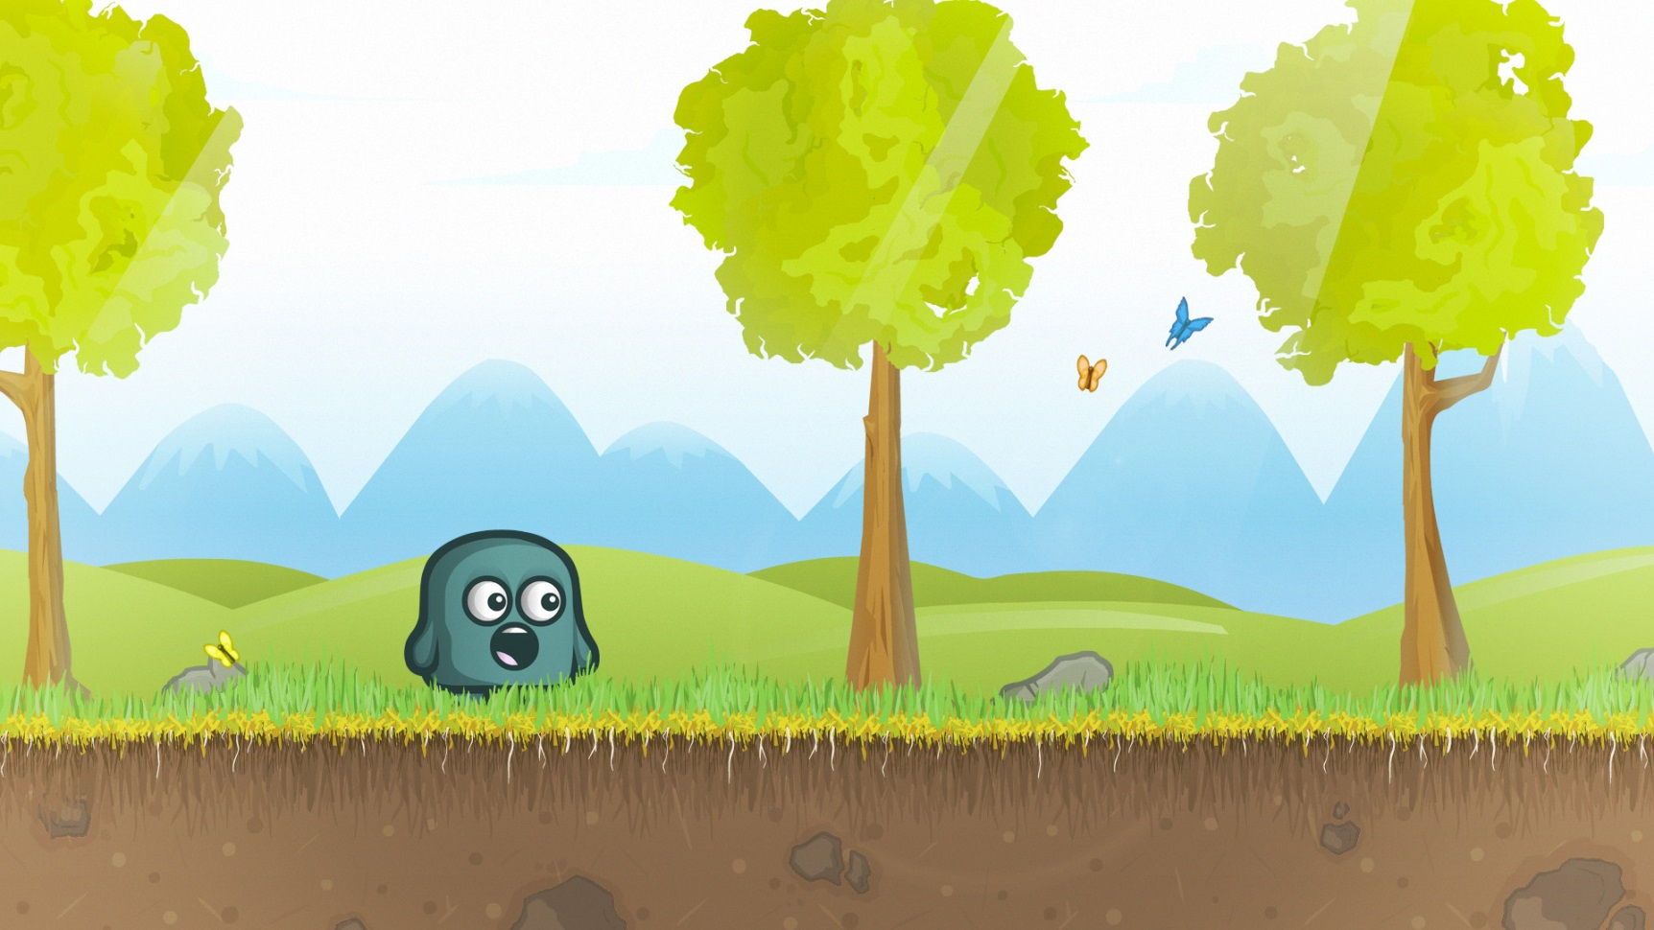
Some games I’ve made

Slide 10
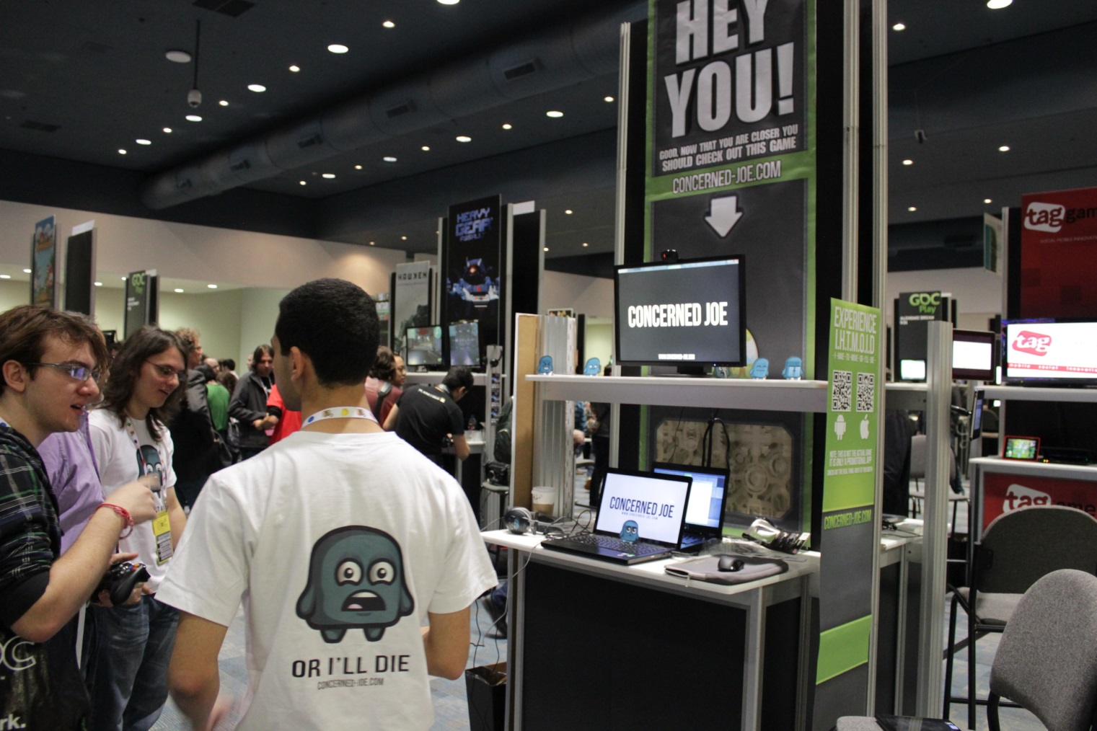
Some games I’ve made

Slide 11



What does it take to make a game?
Programming
Sound
Art
The Three “Pillars” of Game Development
Notes:
Is there anything missing?
Actually, the most important thing is missing (game design)

Slide 12
What is Game Design ?
Notes:
It’s the most neglected, I didn’t know what it was before I started
Hopefully by the end of this talk you’ll have an idea what it is
And why it’s so important

Slide 13
Game Design is:
The act of deciding what a game should be
A game is more than the sum of its parts
Programmers write the code
Artists craft the graphics
Musicians make the music & sfx
Game designers makes the game
Notes:
Be ekhtesar, the game designer is the one who decides what a game should be
The game designer takes all these separate parts and makes an experience out of it
Some examples in the next slide

Slide 14
What sort of decisions?
Big decisions like
The game mechanics & theme (military shooter or sci-fi adventure)
Small decisions like
How high a character jumps
How much health the player has
The speed of the enemies
Level design
Etc..
Notes:
Game design decisions range from big to the tiny

Slide 15
Game Design is a big topic
Notes:
It is impossible to cover in one talk
Experience is vastly important, to know what works and what doesn’t
But I will try to tell you what I’ve learned in game design

Slide 16
Lesson #1 Ideas are cheap, it’s all about execution
Notes:
El fekra mesh fel fekra, el fekra fel tatbee2
Let me tell you about my first game

Slide 17
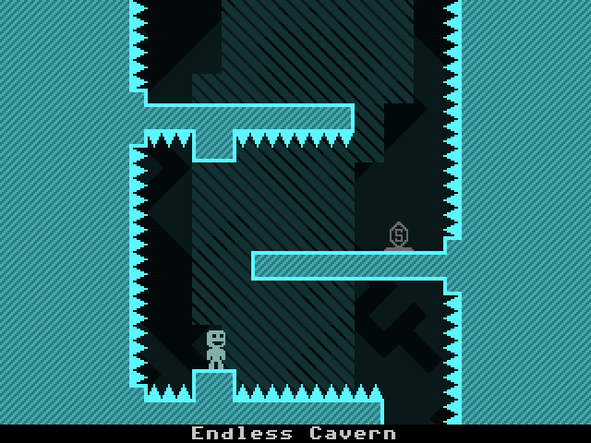
Valiance
VVVVVV
$0
~$600,000
Notes:
My game is about flipping gravity, so is his game
My game earned nothing, his earned millions
They both have the same idea, but VVVV has great execution
They both even have similar code, maybe mine has better graphics
But GAME DESIGN is the difference, hope you’re convinced it’s important

Slide 18
Why were the games different?
He implemented it as a clever puzzle mechanic (mine was added arbitrarily for extra action)
Notes:
Show a pic from VVVVV showing how it makes a simple jump much harder

Slide 19
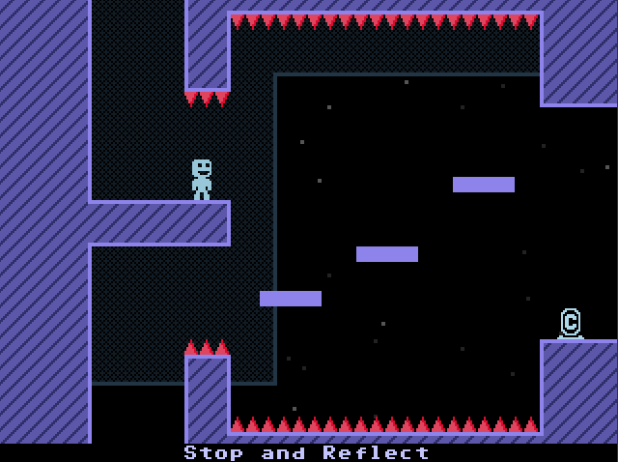
Notes:
Show a pic from VVVVV showing how it makes a simple jump much harder

Slide 20
Why were the games different?
The mechanic was fun: switching gravity was instant
Mine was really slow, and wasn’t really relevant to the game’s theme
Notes:
A lot of thought was put into the mechanic, mine was slow and boring
It was also irrelevant, because the aim of my game was to kill all the enemies in the level
There are way too many problems with my original game, we can see more in detail with the coming lessons

Slide 21
So ideas really are cheap
Everyone has ideas for games
Most people think of games in terms of story or theme, not in terms of game mechanics and design
Whether the idea will make a good game depends on the designer
Notes:
MARIO RETARDED IDEA

Slide 22
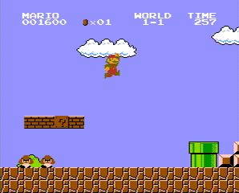
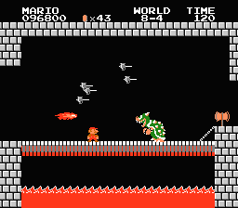
Notes:
Design can trangress limitations

Slide 23
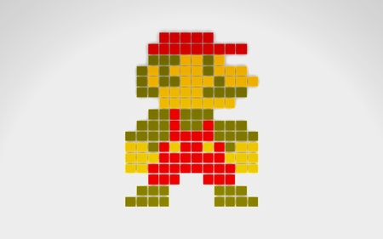
Why Does Mario Have a Mustache?
Notes:
Too small to draw mouth

Slide 24
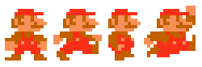
Why Does Mario Wear Overalls?
Notes:
For animation

Slide 25
So how do I know if a game idea is good or not?
Notes:
And this is our next lesson

Slide 26
Lesson #2 Prototyping is crucial!
Notes:
Let me tell you a story

Slide 27
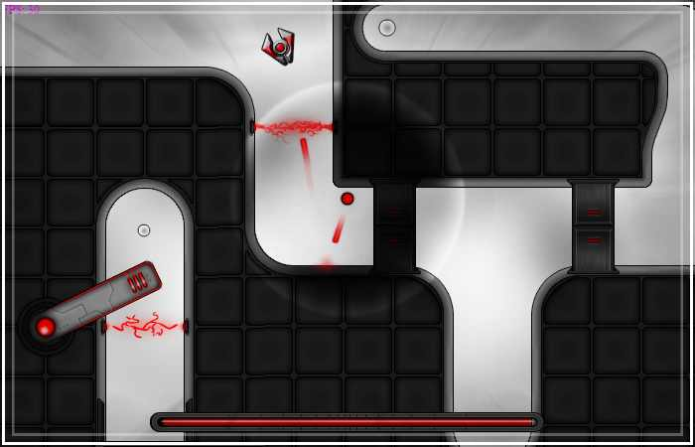
TimeLed
Pic of Joe prototype
Notes:
This is timeled, worked on it for months
-We got this idea for a game, about a red dot, traversing a maze, that can slow down time
-We created: An engine in a month, a level editor in 2 months, enemies, a voice actor, art, etc..
-We started getting bored, we decided to take a break, and made this prototype in a few hours
It was WAY more fun than the 9 month project

Slide 28
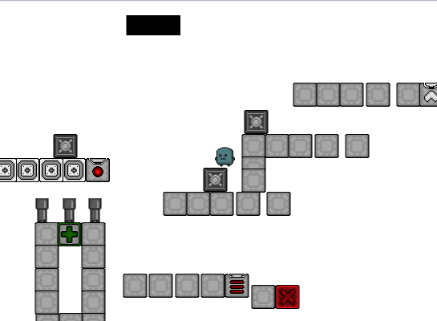
A 4-hour prototype

Slide 29
Concerned Joe was worth
$15,000

Slide 30
Prototyping saves you a lot of effort on an idea that doesn’t work

Slide 31
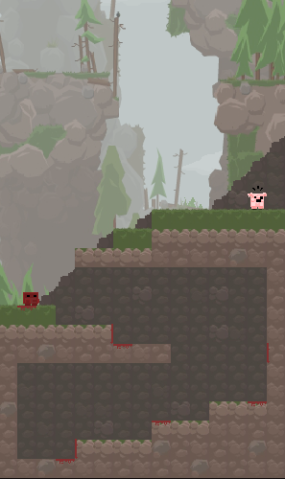
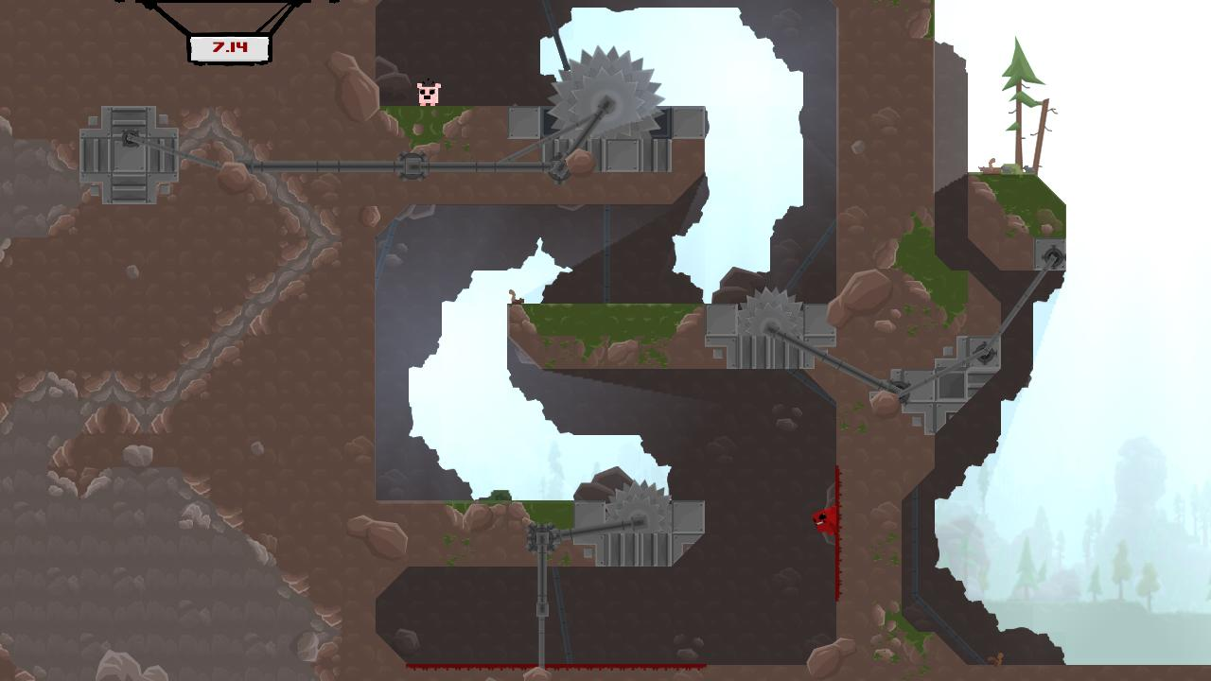
Prototypes can go far
Notes:
It gives you a direction, to know what works and what doesn’t

Slide 32
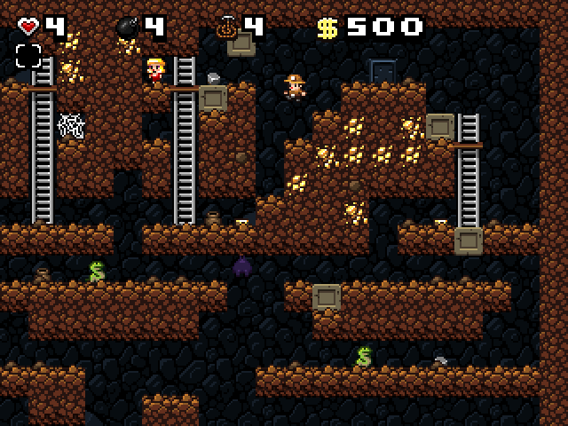
Prototypes can go far

Slide 33
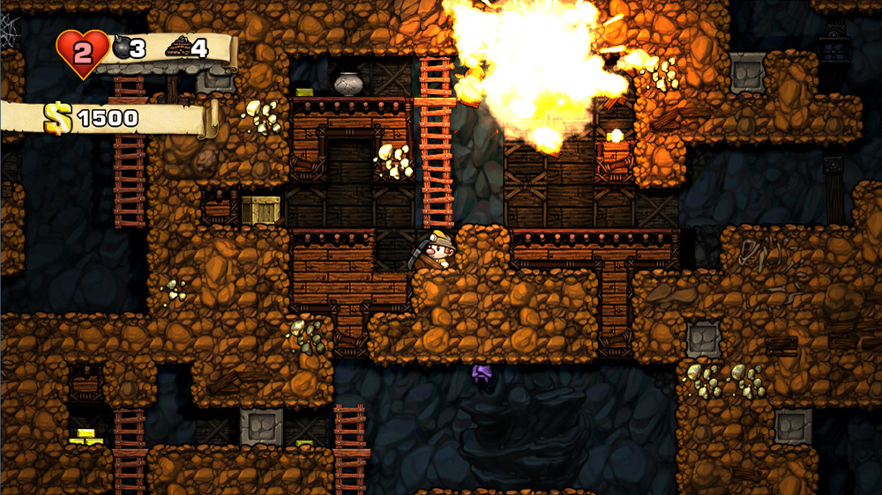
Prototypes can go far

Slide 34
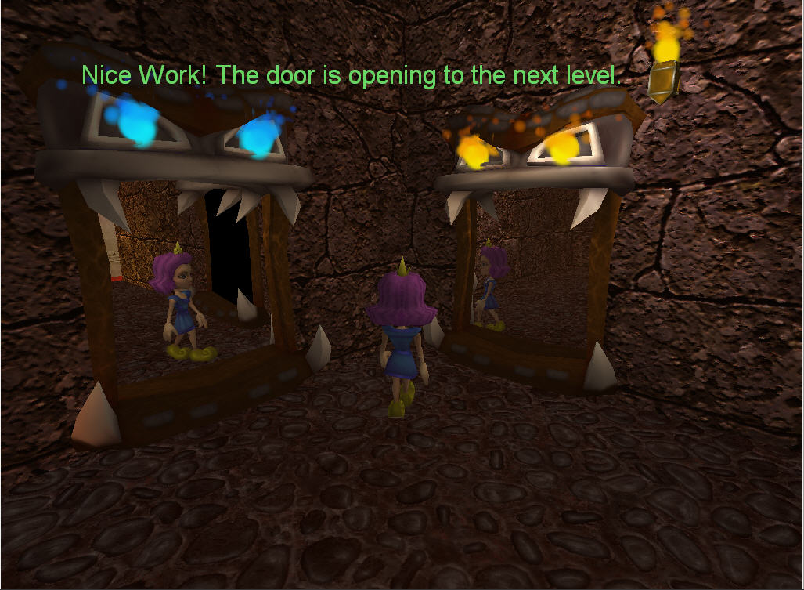
Prototypes can go far

Slide 35

Prototypes can go far

Slide 36
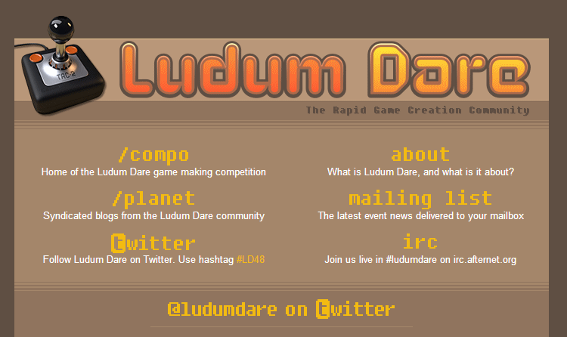
Game Jams are great
Notes:
This is why game jams are a great thing
Mention ludum dare here

Slide 37
Lesson #3 Follow the feedback loop

Slide 38
Idea
Prototype
Development
Release
Testing
Notes:
People think game development looks like this

Slide 39
Development
Feedback
Notes:
But it actually looks like this, you need to get feedback at every step
Let the feedback drive the development

Slide 40
It’s an infinite loop
“Art is never finished,
only abandoned.”
-Leonardo Da Vinci
Notes:
First time I implemented this was in Concerned Joe

Slide 41
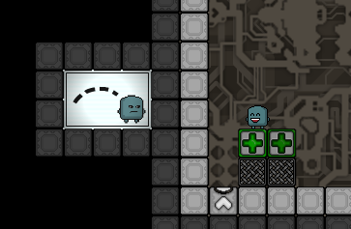
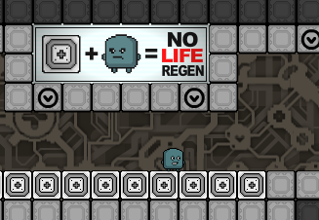
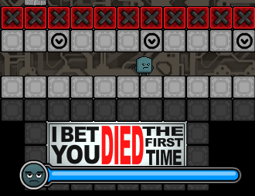
Can it be more exciting?
Notes:
We added little messages throughout the game to make it more interested, it worked!

Slide 42
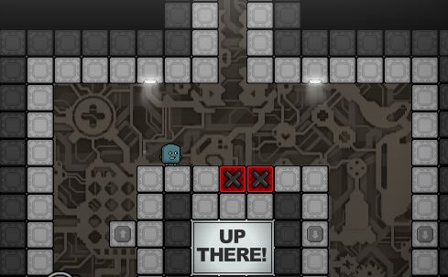
Can it be more exciting?
Notes:
But people felt the world was too small, and no replay value, so we added these tunnels!
These had a very interesting effect!

Slide 43
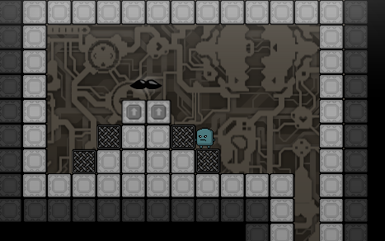
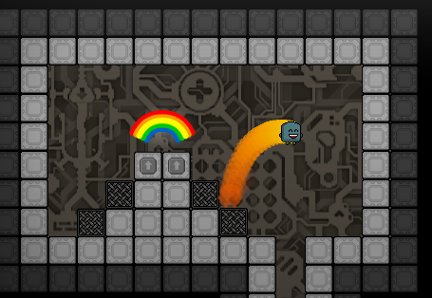
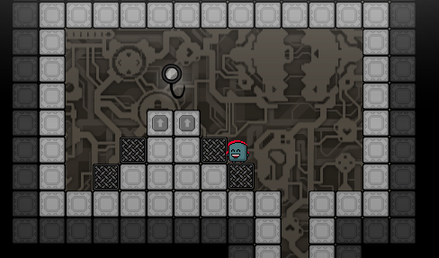
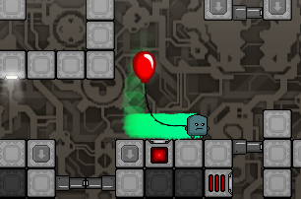

Slide 44

Fork-In-The-Road Trick
Notes:
Very useful trick! Having diverging paths makes the world feel so much bigger than it is.
When you discover 1 secret u didn’t know about, you think, there could be 5 more, or 50, or 500! You don’t know
Ok, now here’s a very important term: polish

Slide 45
Lesson #4 The difference between good and great is polish
Notes:
Polish makes a HUGE difference, [show the vlambeer demo]

Slide 46
Lesson #5 If the player doesn’t know how to play, it’s your fault
Notes:
Imagine this scenario

Slide 47
A Common Scenario
Developer makes a great game
Developer includes an in-depth tutorial in the menu
Players complain the game is too confusing and stop playing
Developer blames players for not reading the tutorial
Notes:
This is completely wrong, no one reads the tutorials

Slide 48
It’s your job as a developer to communicate your game to the player
Notes:
Because if you just say “3amlt el 3alaya” you’re missing out on way better ways to make tutorials

Slide 49
Two main tips
Put the tutorial within the game
Don’t explain everything at once
Notes:
Doesn’t have to be a wall of text, followed by the game, can be demonstrated
Only give players what they need to know

Slide 50
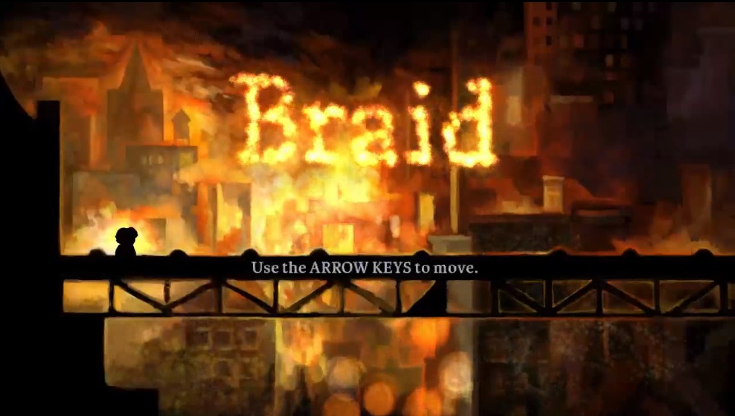
Notes:
Braid for example, just starts with telling you how to move, nothing else
It tells you how to jump when you get to the first gap

Slide 51
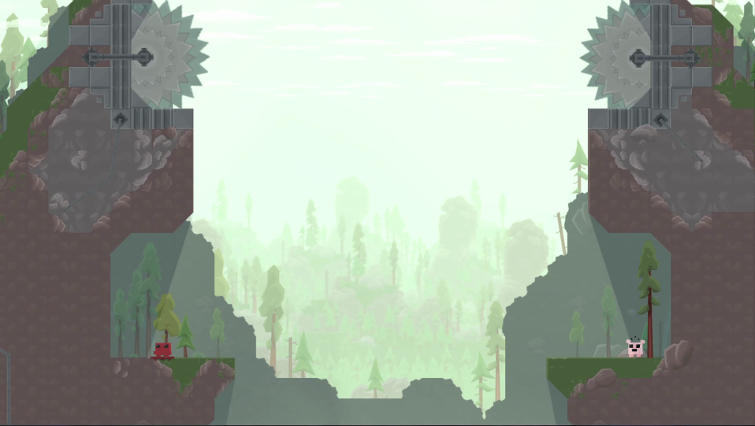
Notes:
Super meat boy did it really well, showing that you can jump farther by running
If you were just told, you’d forget, you have to learn it yourself
There’s no other thing, there’s no distraction

Slide 52
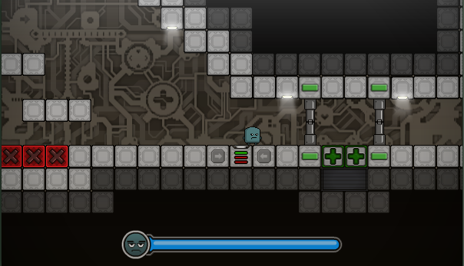
Notes:
As opposed to our own game, where we badly introduced the time button
People didn’t know you had to stand on it, kept trying other things

Slide 53
Lesson #6 Frustration != Difficulty
Notes:
Frustration and difficulty are two different things
Some people make a game hard, but it’s frustrating, not difficult, so players hate it

Slide 54
Frustration comes from
Not being in control
Unfair punishments
Notes:
Like when the player loses because it was the game’s fault

Slide 55
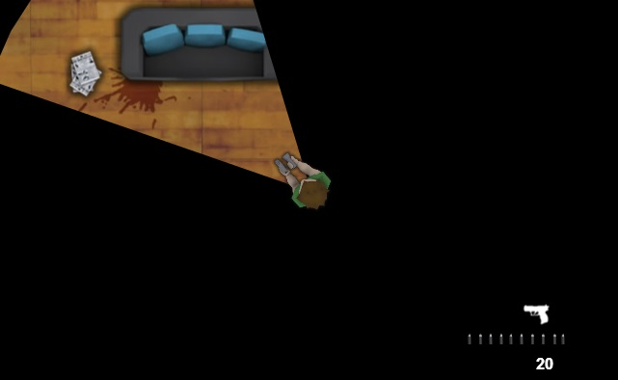
The Game’s Fault
Notes:
Here for example, there’s no indication when zombies are hitting you, that’s unfair!

Slide 56
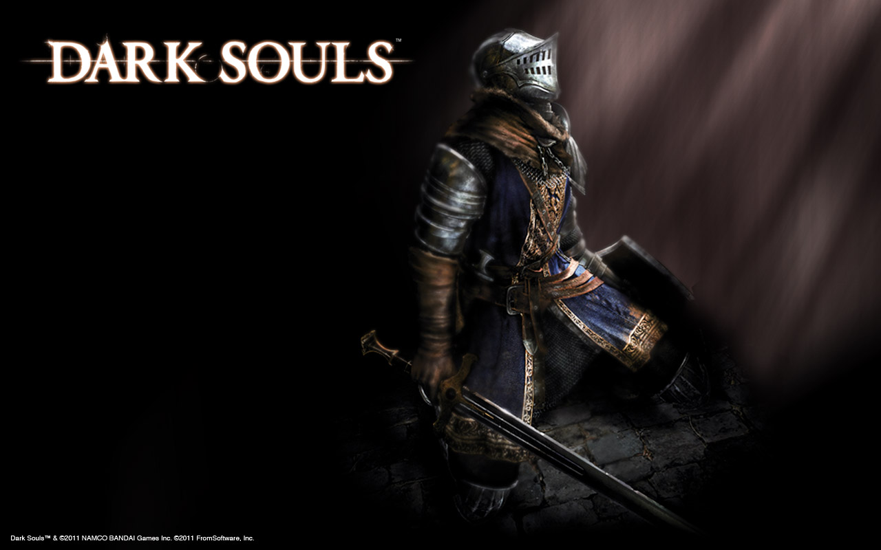
Good Examples
Notes:
Dark Souls is a bruttal difficult game, but NOT frustrating

Slide 57
Dark Souls is brutally difficult, but NOT frustrating
There are many traps, but everything can be avoided if you’re paying attention
The game has consistent rules and does not break them
Notes:
There’s so many traps, but everything can be avoided if you’re good enough
The game has rules and does not break them

Slide 58
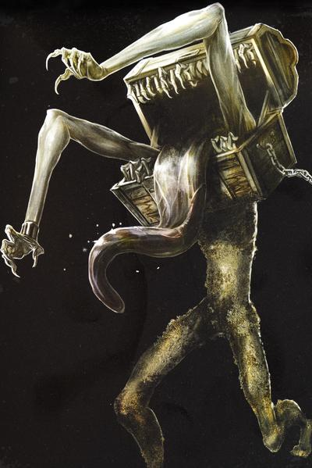
Example
Notes:
Like any game, there are treasure chests, one of them, when you open it, this happens
A lot of people were saying this was unfair, that any chest could be this monster, but actually

Slide 59
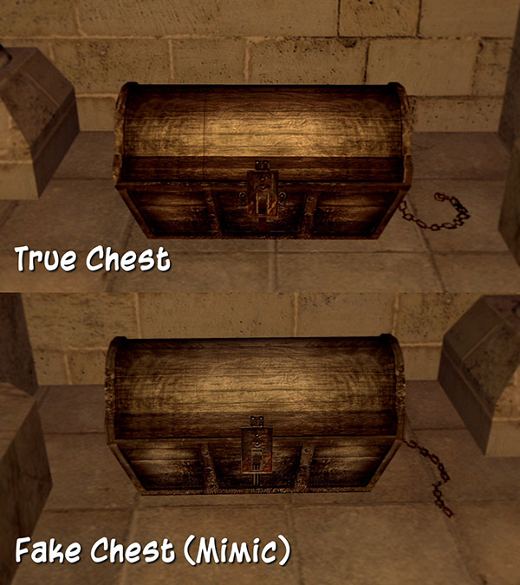
Notes:
There’s a very tiny difference

Slide 60
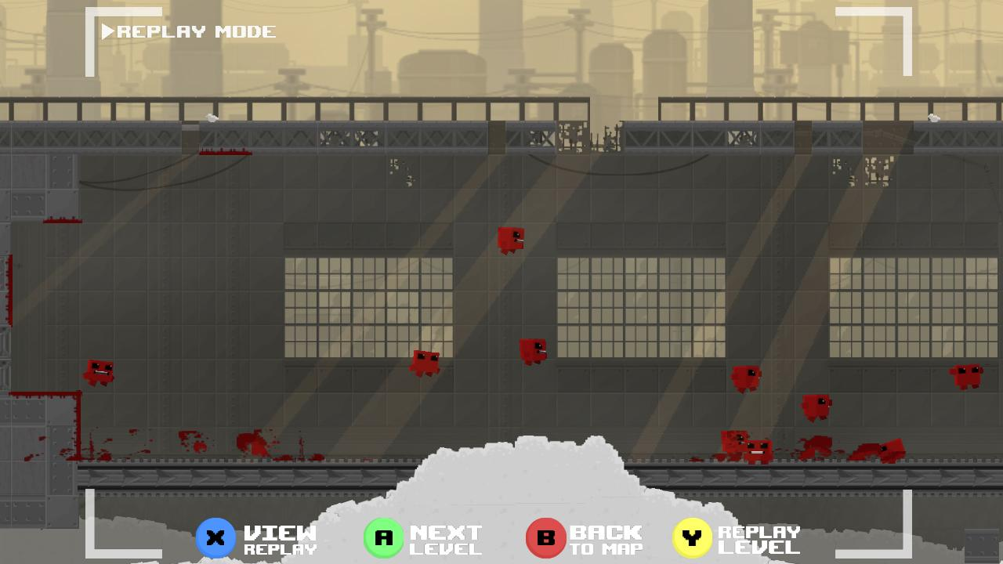
Example
Notes:
Super meat boy also did it well, with instant replay
The time you are not in control is almost non existent

Slide 61
Lesson #7 Your first game will suck
Notes:
You need to expect this, the first game won’t be a massive success, at all
Even if you’re an experienced programmer
Start small, you’ll learn a lot

Slide 62
Lesson #8 Games are not movies
Notes:
This is a problem in the way we look at games
The problem is in understanding the capabilities of the new medium

Slide 63
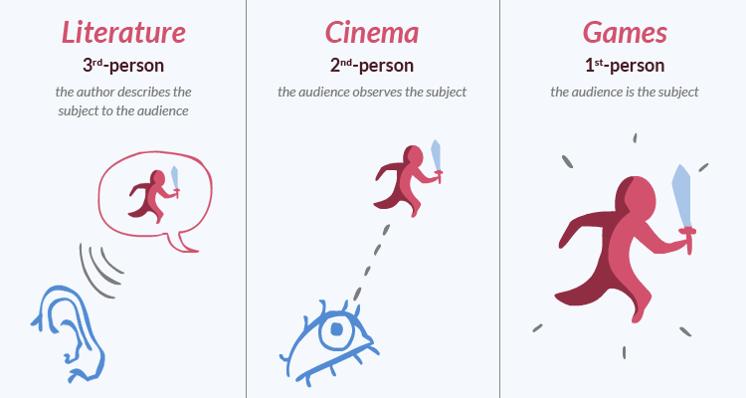
Understanding the new medium

Slide 64

Notes:
Like silent films

Slide 65
You don’t need to take control away from the player
Notes:
Dark souls is a good example, but there’s an even better one

Slide 66
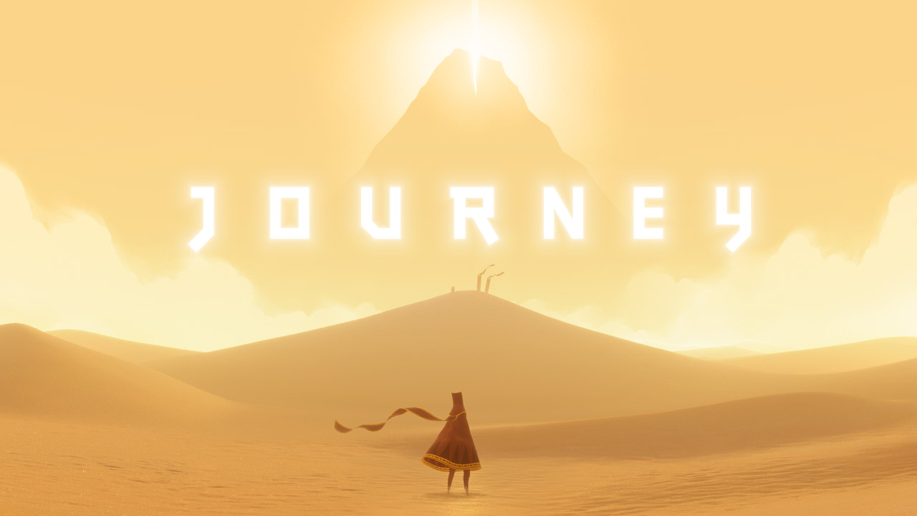
A Great Example
Notes:
Tell my story

Slide 67
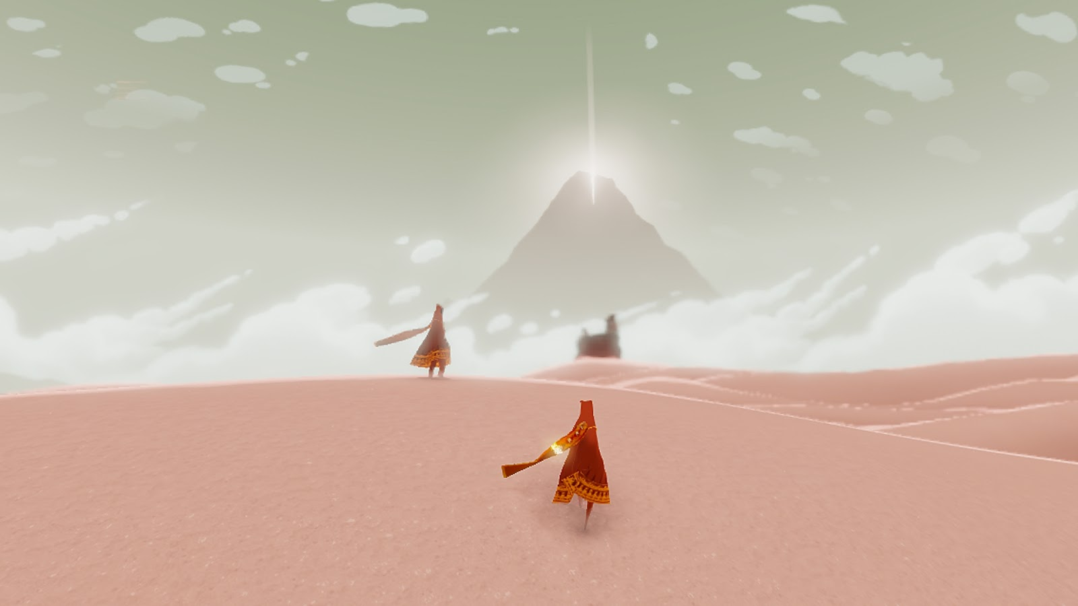

Slide 68
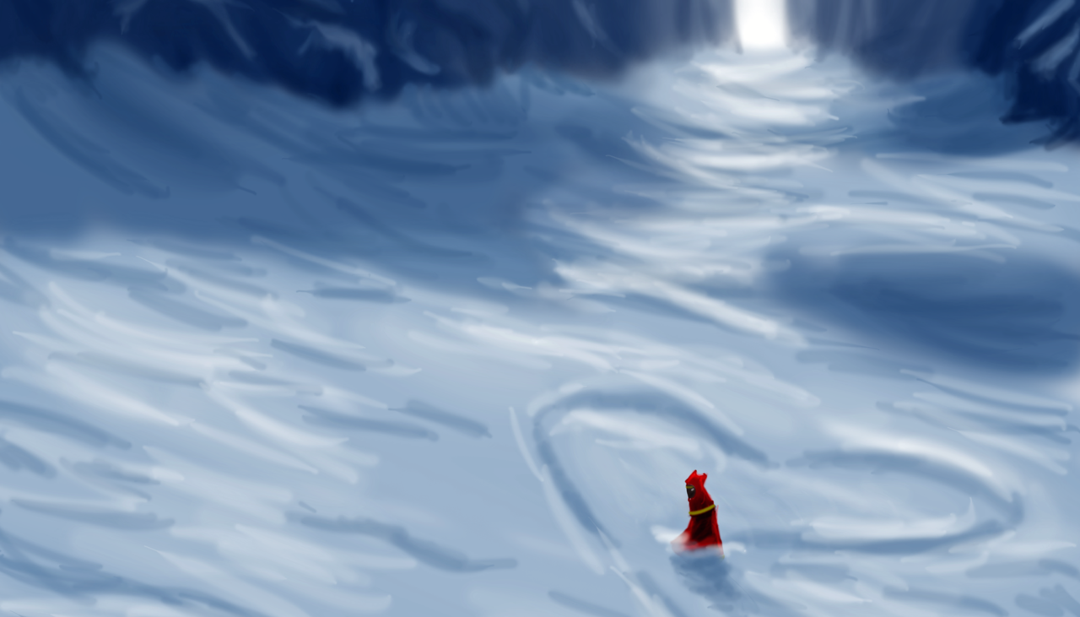

Slide 69
Journey shattered the cultural and language barrier

Slide 70
Lesson #9 Games are can make a difference
Notes:
We 3ashan keda I make a games, it’s bigger than leisure, it’s art

Slide 71
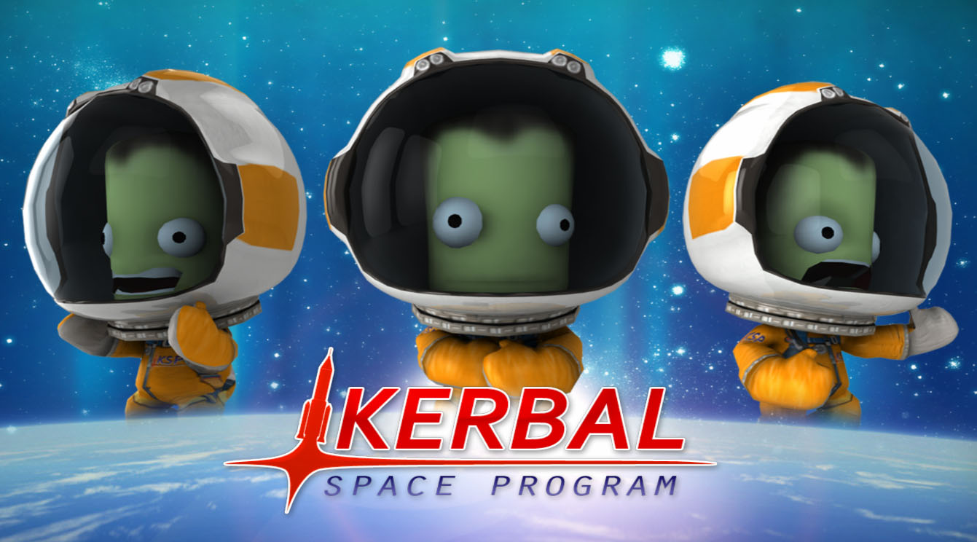
Games can teach

Slide 72
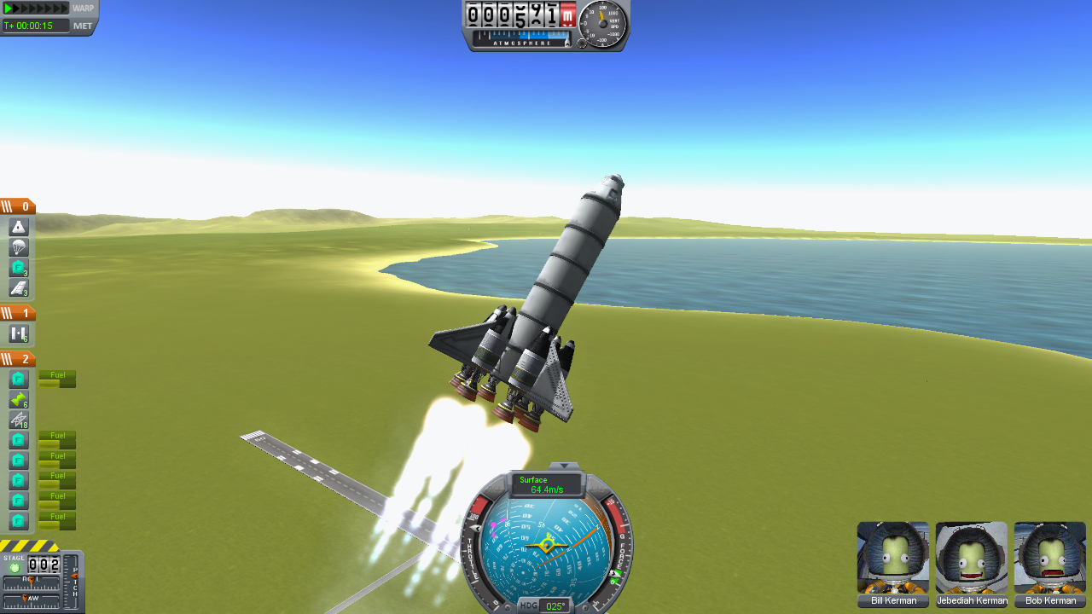
Games can teach

Slide 73
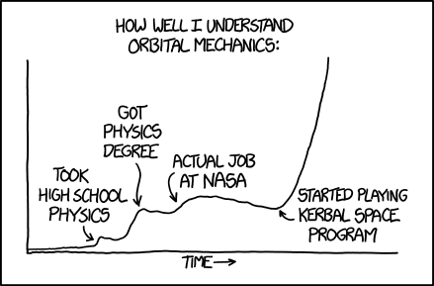
Games can teach

Slide 74
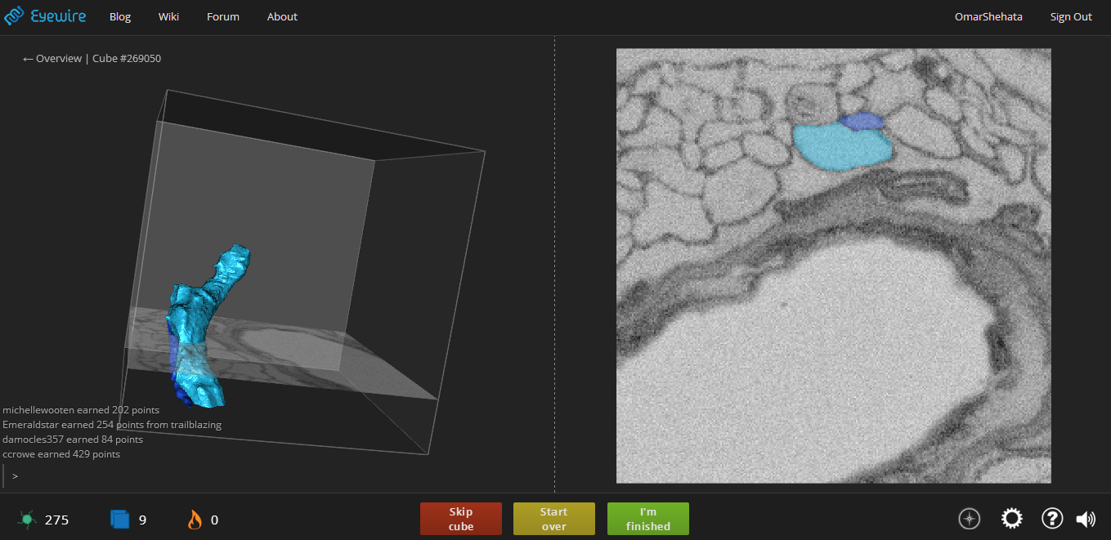
Games can advance science

Slide 75

Games can advance science

Slide 76
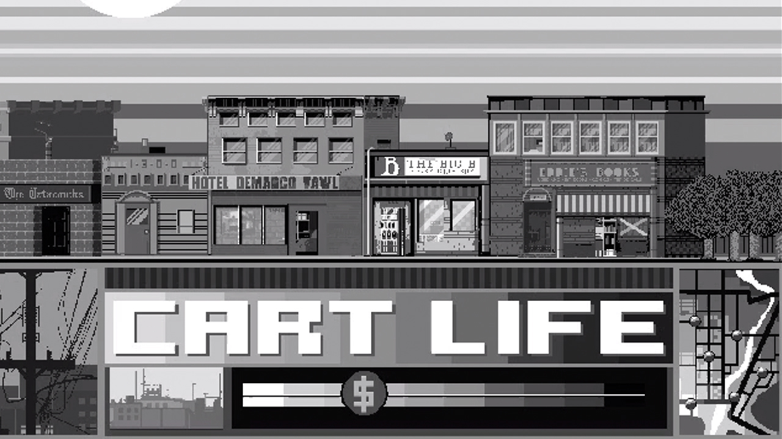
Games can change prespective
Notes:
Newspaper stand, not knowing where to eat, no one is there to help you with map

Slide 77
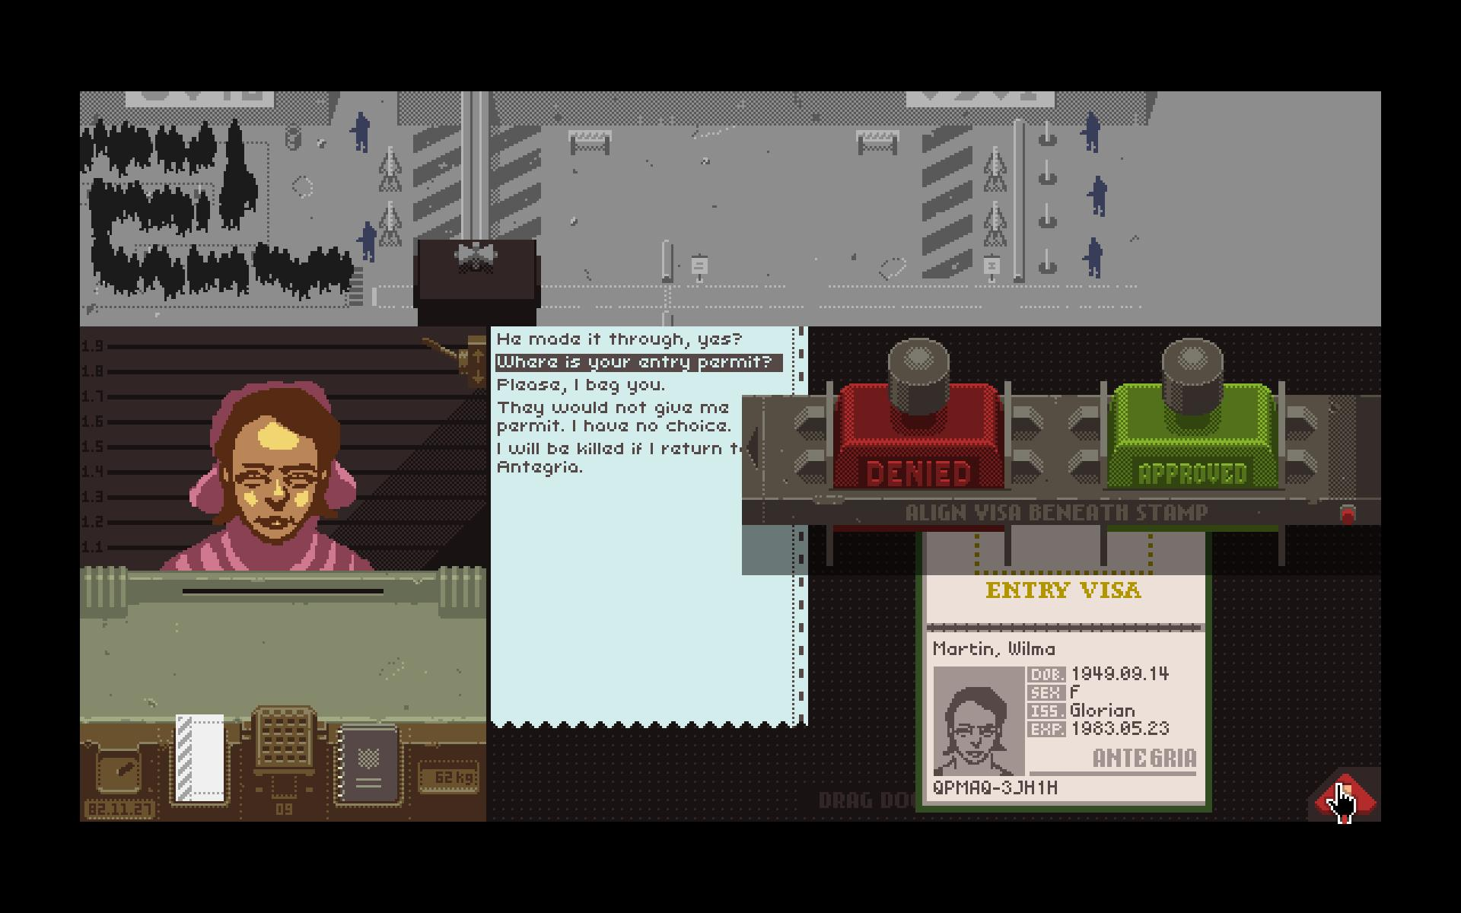
Games can change prespective
Notes:
Take bribe and let someone in?
Make sure someone stays out?

Slide 78
Make Games
Notes:
No matter who you are or what field you’re interested in, as way to communicate and express

Slide 79
www.catreloaded.org/bootcamp/resources Thank you!

